Slide 1

Introduction to High-Performance Computing
Martijn Oldenhof

Slide 2
Introduction to High-Performance Computing
Introduction HPC
General concepts of HPC
What is a cluster?
What are Accelerators?
CPU vs GPU architecture
Python and HPC
Discussion and Q&A

Slide 3
What is HPC?
High Performance Computing (HPC) uses supercomputers and computer clusters to solve advanced computation problems.

Slide 4
What a supercomputer is NOT

Slide 5
Actually, it is more like …

Slide 6
General concepts of HPC
Moore’s law
Parallel computing
Amdahl’s law
Scalability

Slide 7
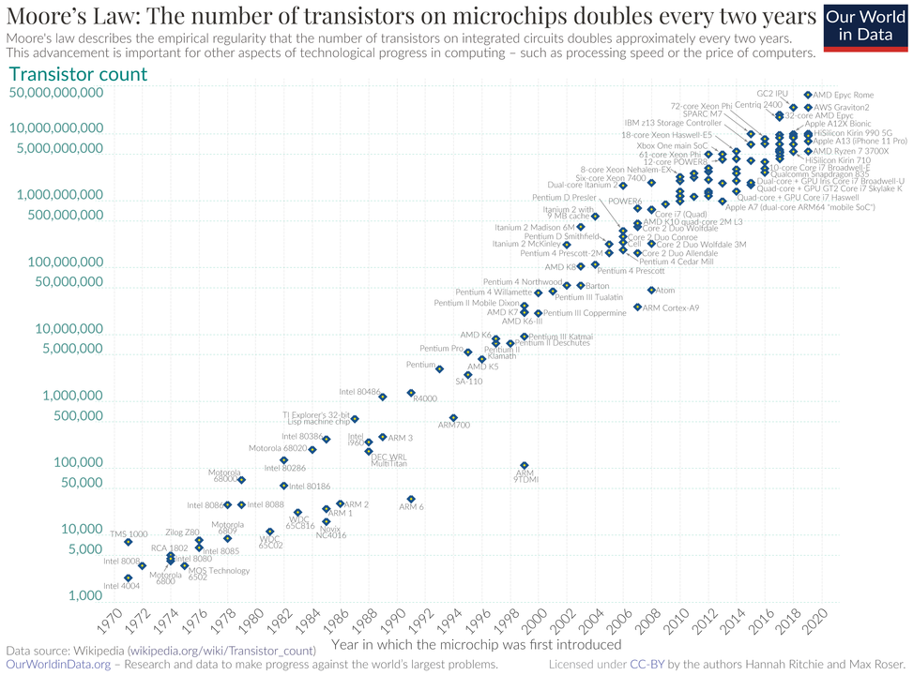
Moore’s law
Gordon Moore: co-founder of Fairchild Semiconductor and Intel (and former CEO of the latter)
Observed: Number of transistors on chips doubles every 2 years

Slide 8

Parallel Computing
Consider your favourite computational application
One processor can give results in N hours
Why not use N processors -- and get the results in just one hour?
The concept is simple: Parallelism = applying multiple processors to a single problem

Slide 9
Parallel Computing
Serial:
one program, on one core
Embarrassingly parallel’ problems:
lots of runs of one program, with different parameters
Problems that require ’real’ parallel algorithms
OpenMP
MPI : Message Passing Interface

Slide 10
Scalability
Strong Scaling:
Same problem but more resources
Ideally:
Weak Scaling
Larger problem and more resources
Ideally:
execution time
nr. processes
system size
execution time ∼
nr. processes

Slide 11


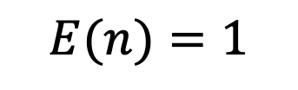

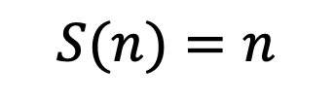
Some definitions
Parallel speedup $S(n)$ for $n$ processes:
Ideally,
Parallel efficiency $E(n)$ for $n$ processes:
Ideally,
$$S(n)=\frac{T_{1}}{T_{n}}$$
$$S(n)=n$$
$$E(n)=\frac{T_{1}}{nT_{n}}$$
$$E(n)=1$$

Slide 12
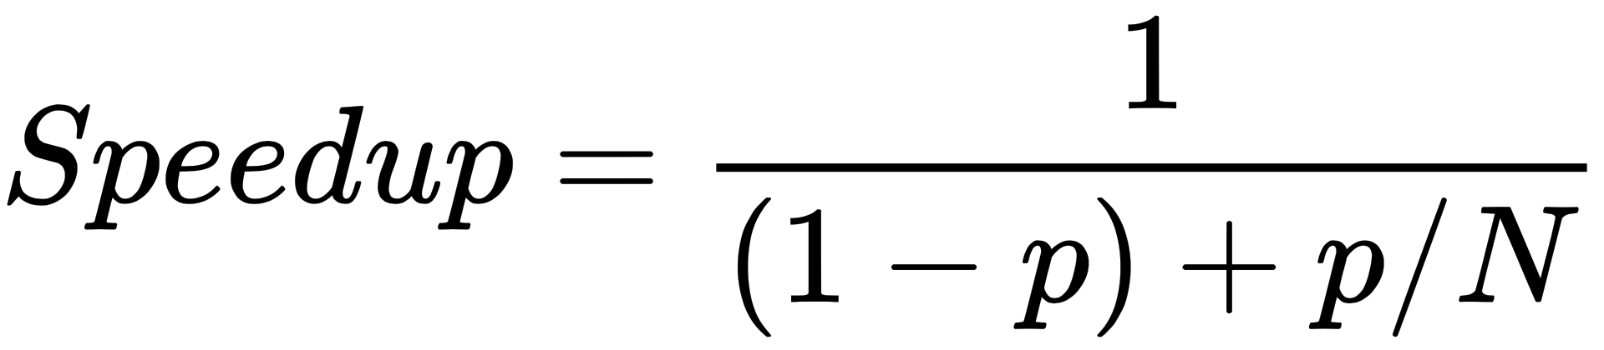
Strong Scaling and Amdahl’s law
In general terms, Amdahl’s Law states that in parallelization, if P is the proportion of a system or program that can be made parallel, and 1-P is the proportion that remains serial, then the maximum speedup S(N) that can be achieved using N processors is:
As N grows the speedup tends to 1/(1-P).

Slide 13
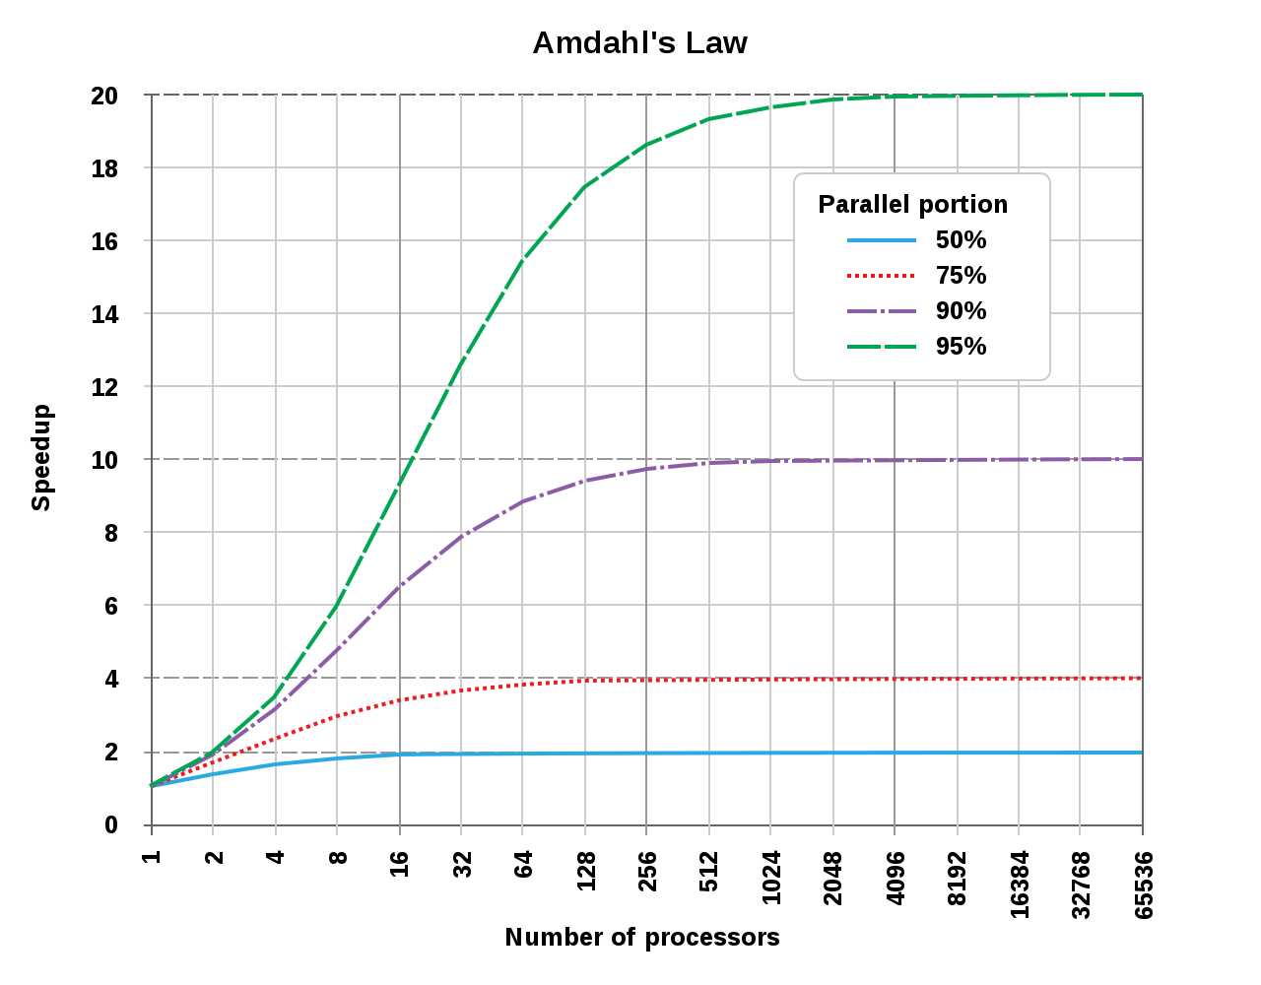
Amdahl’s law
Example: Speedup is limited by the total time needed for the sequential (serial) part of the program. For 10 hours of computing, if we can parallelize 9 hours of computing and 1 hour cannot be parallelized, then our maximum speedup is limited to 10 times as fast. If computers get faster the speedup itself stays the same.

Slide 14
It gets worse …
Overhead!
communication takes time
finite bandwidth
non-zero latency
resource contention
memory subsystem: L3 cache, RAM, QPI
network access
speedup
nr. processes

Slide 15
Picking the sweet spot
sweet spot
sweet spot
speedup
efficiency
nr. processes
nr. processes

Slide 16
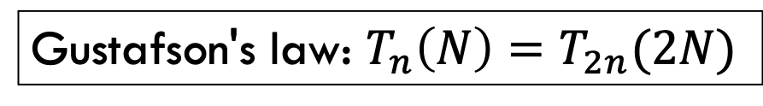
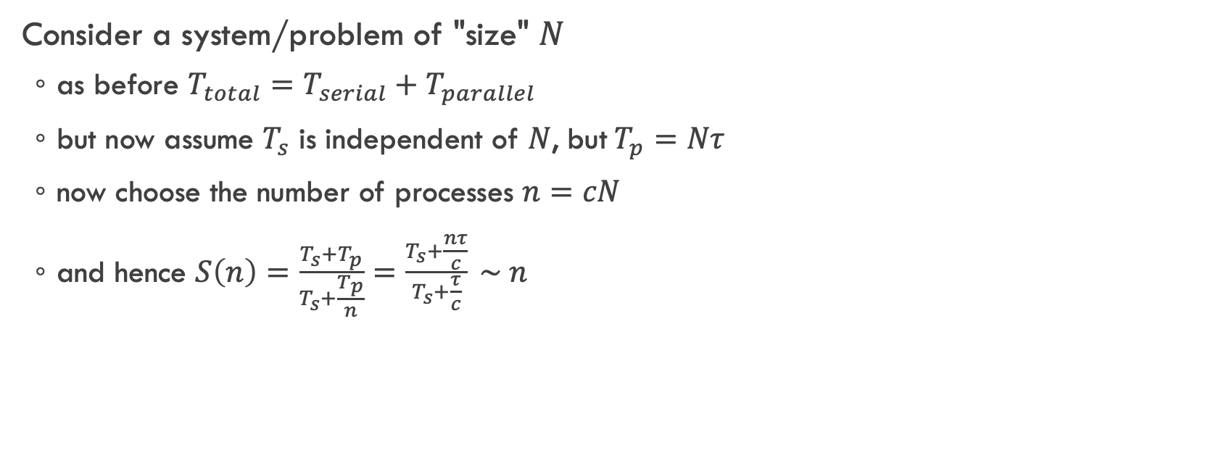
Weak Scaling
Consider a system/problem of "size" $N$
as before $T_{total}=T_{serial}+T_{parallel}$
but now assume $T_{s}$ is independent of $N$, but$T_{p}=Nτ$
now choose the number of processes $n=cN$
and hence $S\left(n\right)=\frac{T_{s}+T_{p}}{T_{s}+\frac{T_{p}}{n}}=\frac{T_{s}+\frac{nτ}{c}}{T_{s}+\frac{τ}{c}} \sim n$
Scientist are interested in
studying larger systems/bigger data sets
increasing precision/resolution
…
Gustafson's law: $T_{n}\left(N\right)=T_{2n}(2N)$

Slide 17
Be careful!
Scalability is key issue?????
Single core performance is not important?????

Slide 18
Use Case Scalibility
core0
core1
core2
core3
L1
L2
L1
L2
L1
L2
L1
L2
Prepared for parallel era?
L3
core4
core5
core6
core7
L1
L2
L1
L2
L1
L2
L1
L2
Main Memory

Slide 19
Use Case Scalibility
Max Perf.
core0
core1
core2
core3
L1
L2
L1
L2
L1
L2
L1
L2
L3
core4
core5
core6
core7
L1
L2
L1
L2
L1
L2
L1
L2
Main Memory

Slide 20
General concepts of HPC
Moore’s law
Parallel computing
Amdahl’s law
Scalability

Slide 21
Introduction to High-Performance Computing
Introduction HPC
General concepts of HPC:
What is a cluster?
What are Accelerators?
CPU vs GPU architecture
Python and HPC
Discussion and Q&A

Slide 22

What is a cluster?
Many independent computers, i.e., compute nodes
each with its own operating system, memory, hard disk,…
Interconnected via fast network
E.g Infiniband
Accessed via login nodes
For job submission, debugging, pre/post processing
Possible shared resources
Administrated using service nodes
Queue system, job scheduler, user management,…
Storage system

Slide 23
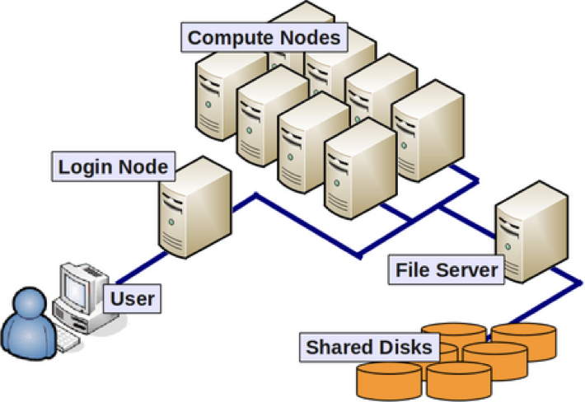
Bird’s eye view of HPC cluster

Slide 24
Why do you need a cluster?
To perform computations that don’t fit on desktop
Studying large systems (compute/memory intensive)
Complicated models (compute intensive)
Many independent settings/parameters

Slide 25
What a cluster is not …
A computer that automatically will run your application
much faster
for much bigger problems
in parallel
May be possible, but requires (at least some) work

Slide 26
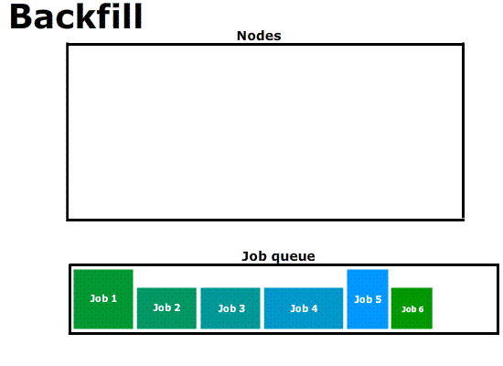
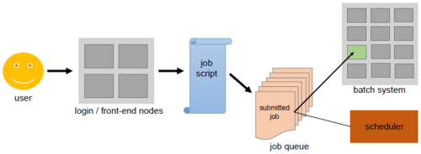
Job submission & execution
Source: https://hpc-wiki.info/hpc/Scheduling_Basics
Source: Adaptive Computing

Slide 27
What are HW accelerators?
Hardware accelerator: This is used to enhance the speed and performance of the computer as it works by performing functions faster than the central processing unit (CPU).
E.g. GPU and FPGA

Slide 28
GPU accelerated computing
GPU accelerated computing is the use of a graphics processing unit (GPU) together with a CPU to accelerate applications .
GPU accelerated computing offers better performance by offloading compute intensive portions of the application to the GPU, while the remainder of the code still runs on the CPU. From a user's perspective, applications simply run significantly faster.

Slide 29
CPU vs GPU
CPU design goal : optimize architecture for sequential code performance : minimize latency experienced by 1 thread
sophisticated (i.e. large chip area) control logic for instruction level parallelism (branch prediction, out of order instruction, etc...)
CPU have large cache memory to reduce the instruction and data access latency
GPU design goal : maximize throughput of all threads
threads in flight limited by resources => lots of resources (registers, bandwidth ,etc)
multithreading can hide latency => skip the big caches
share control logic across many threads

Slide 30
CPU vs GPU
GPU Devotes More Transistors to Data Processing (is designed such that about 80% of transistors are devoted to data processing rather than data caching and flow control - the same function is executed on each element of data with high arithmetic intensity ).

Slide 31
Python and (high) performance
Why is (vanilla) Python slow?
“It’s the GIL (Global Interpreter Lock)”
“It’s because its interpreted and not compiled”
“It’s because its a dynamically typed language”

Slide 32
“It’s the GIL (Global Interpreter Lock)”
What is a lock?
To avoid multi threaded applications to access/change memory locations at same time.
In Python:
There is a “global interpreter lock” that carefully controls thread execution. The interpreter can only execute one operation at a time, regardless of how many threads it has.

Slide 33
Impact of GIL on multi-threaded Python Programs
Impact of GIL depends:
Is your program CPU or I/O bound?
CPU bound program:
Your program does not have performance gain (one thread at the time) + overhead multi-thread => program becomes slower!!
I/O bound program:
Program might experience performance gain as one thread can execute while the other(s) wait for I/O.

Slide 34
“It’s because its interpreted and not compiled”
Python code is interpreted at runtime instead of being compiled to native code at compile time
Source Code
Compiler
Machine Code
Output
Source Code
Interpreter
Output

Slide 35
“It’s because its a dynamically typed language”
Statically-typed languages require you to declare the data types of your variables before you use them, while dynamically-typed languages do not.
//C or Java example
int num; num = 5;
More room for optimisation at compile-time
VS
#Python example num = 5

Slide 36
Why use Python?
Simple to program: optimise development time vs computation

Slide 37
What to do if you need performance using Python?
Use libraries
For example for numeric computation:
NumPy:
Fast arrays
Matrix operations (BLAS-like)
Fast Fourier Transform
Mathematical functions defined on arrays
Pseudo-random number generation to initialize arrays
Simple statistics
SciPy:
More mathematical functions
Mathematical & physics constants
Numerical integration
Ordinary differential equations
Optimization
Interpolation
Signal processing
Dense and sparse linear algebra
Pandas: data science

Slide 38
Multicore programming in Python
Threads in Python:
Not a big success
Global Interpreter Lock (GIL)
Does not influence threaded libraries
e.g., numpy:
numpy build on top of BLAS (Basic Linear Algebra Subpackage)
Good BLAS implementation are multithreaded
OpenBLAS
Intel MKL
…
To exploit multiple cores efficiently, use processes

Slide 39
Python: multiprocessing

Slide 40
Python: multiprocessing
Process | Thread
Separate memory | Shared memory
Consumes more memory | Consumes less memory
Children can become zombies | No zombies possible
More overhead | Less overhead
Slower to create/destroy | Faster (lightweight) to create/destroy
Easier to code/debug | Can become complex to debug/code

Slide 41

Example
Count nucleotides in DNA sequence: how many A, C, G, T
Process 0
Process 1
AGTCATCCAAGTGGTGATAT
TATTGCCGGCGAGTAACTAT
CGATCTTAGACATCTGTATT
AAGAGAAGTTACTAGCGGGA
Process 2
aggregate
Process 3
From : https://gjbex.github.io/Python-for-HPC/ (by Geert Jan Bex)

Slide 42
Count a chunk
Given: file name, start position, chunk size
Return: dict of counts
tuple as input!
def count_chunk(args):
file_name, file_pos, chunk_size = args
counter = {'A': 0, 'C': 0, 'G': 0, 'T': 0}
with open(file_name, 'r') as file:
file.seek(file_pos)
dna = file.read(chunk_size)
for char in dna:
if char in counter:
counter[char] += 1
return counter
From : https://gjbex.github.io/Python-for-HPC/ (by Geert Jan Bex)

Slide 43
Throw'em in the pool!
nr. of processes
tuples as input
def count_nucl(file_name, pool_size):
file_size = os.path.getsize(file_name)
chunk_size = file_size//pool_size + 1
offsets = range(0, file_size, chunk_size)
args = [(file_name, offset, chunk_size)
for offset in offsets]
with multiprocessing.Pool(pool_size) as pool:
counters = pool.map(count_chunk, args)
counter = {'A': 0, 'C': 0, 'G': 0, 'T': 0}
for part_counter in counters:
for nucl in part_counter:
counter[nucl] += part_counter[nucl]
return counter
pool of processes
concurrent processing
aggregating results
From : https://gjbex.github.io/Python-for-HPC/ (by Geert Jan Bex)

Slide 44
Scaling
C application
10⁹ bases: 21 s
speedup
cores
From : https://gjbex.github.io/Python-for-HPC/ (by Geert Jan Bex)

Slide 45
Pool methods
apply: call function with single argument, blocking
apply_async: call function with single argument, non-blocking
map/imap: call function on each of iterable, blocking
map_async: call function on each of iterable, non-blocking
starmap: call function on each of iterable, itself iterables and unpacked as arguments, blocking
starmap_async: call function on each of iterable, itself iterables and unpacked as arguments, non-blocking
From : https://gjbex.github.io/Python-for-HPC/ (by Geert Jan Bex)

Slide 46
Results
Asynchronous methods return AsyncResult objects with methods
wait(): blocks till result is ready
get(): blocks till result is ready, then returns it
ready(): True when result is ready
successful(): True when no exceptions where raised, only call when ready
Both take optional time out value
From : https://gjbex.github.io/Python-for-HPC/ (by Geert Jan Bex)

Slide 47
Shared memory
Explicitly work with Process
Processes can share
Single value: multiprocessing.Value
Array: multiprocessing.Array
Syncronized FIFO queue: multiprocessing.Queue
Shared variables should be locked for non-atomic update operations
From : https://gjbex.github.io/Python-for-HPC/ (by Geert Jan Bex)

Slide 48
Computing a part of π
def partial_pi(nr_tries, p_sum):
nr_hits = 0
for _ in range(nr_tries):
x = random.random()
y = random.random()
if x**2 + y**2 < 1.0:
nr_hits += 1
with p_sum.get_lock():
p_sum.value += 4.0*nr_hits/nr_tries
shared variable
acquire lock
non-atomic update load/store operation
From : https://gjbex.github.io/Python-for-HPC/ (by Geert Jan Bex)

Slide 49
Computing it all
create a context
create shared variable
def compute_pi(nr_tries=10000, pool_size=1):
p_tries = nr_tries//pool_size
ctx = multiprocessing.get_context('forkserver')
p_sum = ctx.Value('d', 0.0)
processes = [ctx.Process(target=partial_pi,
args=(p_tries, p_sum))
for _ in range(pool_size)]
for process in processes:
process.start()
for process in processes:
process.join()
return p_sum.value/pool_size
create processes
start all processes
wait for all processes
concurrent processing
From : https://gjbex.github.io/Python-for-HPC/ (by Geert Jan Bex)

Slide 50
Distributed Computing with Python

Slide 51
What is distributed computing?
Processor(s)
Processor(s)
Communication
Main Memory
Main Memory
Processor(s)
Main Memory

Slide 52
Distributed computing with Python
Dask
Out of core computation
Distributed computing
mpi4py
PySpark

Slide 53
Dask: Motivation
Data sets can be very large
many files
large files
entire set doesn't fit in RAM
Computation can be decomposed into graph of subtasks
some (maybe many) subtasks can be done in parallel
Out-of-core computation
Parallel/distributed computation
From : https://gjbex.github.io/Python-for-HPC/ (by Geert Jan Bex)

Slide 54
Out of core computation
Data set: time series in CSV files
time stamp + 100 variables
200000 measurements/file
800 files
data spans 12 months period
Task: compute average of each variable, grouped by month
289 GB
Trivial using pandas, but…
memory!
From : https://gjbex.github.io/Python-for-HPC/ (by Geert Jan Bex)

Slide 55
Dask solution
differences with pandas
files not yet read
import dask.dataframe as dd
…
df = dd.read_csv('data/time_series_*.csv', parse_dates=['timestamp'])
result = df.groupby(df.timestamp.dt.month).mean()
result.compute().to_csv('data/result.csv')
computations not yet done
Entire computation decomposed into subtasks that
fit in RAM,
can be done in parallel
computations are carried out
From : https://gjbex.github.io/Python-for-HPC/ (by Geert Jan Bex)

Slide 56
Efficiency
more code: read files one by one, how to do group-by?
pandas
800 × 7.29s = 5832s ≈ 1 hour, 37 minutes
Intel E5-2680v2 @ 2.80GHz, 1 core
Dask
16 minutes
dual socket Intel E5-2680v2 @ 2.80GHz, 20 cores
Speedup: 6 times
parallel efficiency: 30 %
Not great, but I/O bound
From : https://gjbex.github.io/Python-for-HPC/ (by Geert Jan Bex)

Slide 57
Data structures
Dask supports
dataframe (cfr. pandas.DataFrame)
from e.g., CSV files
array (cfr. numpy.ndarray)
from e.g., HDF5 files
bag: set-like operations
delayed: parts to be composed later
From : https://gjbex.github.io/Python-for-HPC/ (by Geert Jan Bex)

Slide 58
Dask: distributed computing
Components
scheduler
workers
client
worker
task + data
result(s)
worker
scheduler
workers on different compute nodes
…
worker
task + data
task graph
result(s)
result(s)
worker
client
From : https://gjbex.github.io/Python-for-HPC/ (by Geert Jan Bex)

Slide 59
Setting up & executing
From : https://gjbex.github.io/Python-for-HPC/ (by Geert Jan Bex)
#!/bin/bash -l
#PBS -l nodes=3:ppn=20
#PBS -l walltime=00:30:00
scheduler="$(hostname):8786"
worker_nodes=$(uniq $PBS_NODEFILE)
nohup dask-scheduler &>> "scheduler.log" &
sleep 15
for worker in $worker_nodes;
do
ssh $worker "nohup dask-worker $scheduler &" &
done
sleep 15
cd $PBS_O_WORKDIR
./dask_distr_avg_csv.py $VSC_SCRATCH/data
start Dask scheduler
start Dask workers
start Dask client

Slide 60
Dask client
differences with non-distributed Dask
import dask.dataframe as dd
from distributed import Client
…
client = Client('{0}:{1}'.format(scheduler_host,
scheduler_port))
df = dd.read_csv('data/time_series_*.csv', parse_dates=['timestamp'])
result = df.groupby(df.timestamp.dt.month).mean()
result.compute().to_csv('data/result.csv')
From : https://gjbex.github.io/Python-for-HPC/ (by Geert Jan Bex)

Slide 61
Distributed computing with Python
Dask
Out of core computation
Distributed computing
mpi4py
PySpark

Slide 62
Introduction to High-Performance Computing
Introduction HPC
General concepts of HPC
What is a cluster?
What are Accelerators?
CPU vs GPU architecture
Python and HPC
Discussion and Q&A

