Slide 1
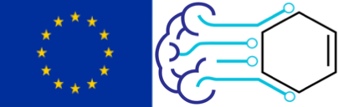
Generative models and optimization for molecules
Dr. Rocío Mercado
Department of Chemical Engineering, MIT
Advanced Machine Learning for Innovative Drug Discovery (AIDD)
Tuesday October 26, 2021

Slide 2
Outline
Introduction
Methods
Benchmarks
Outlook
Architectures used in generative models
Evaluating generative models
Optimization strategies
About the speaker
General classes of generative models
Molecular representations
Generation schemes
Advantages of generative models
Challenges and future work
Introduction
Methods
Benchmarks
Outlook

Slide 3
Introduction
Introduction
Methods
Benchmarks
Outlook

Slide 4
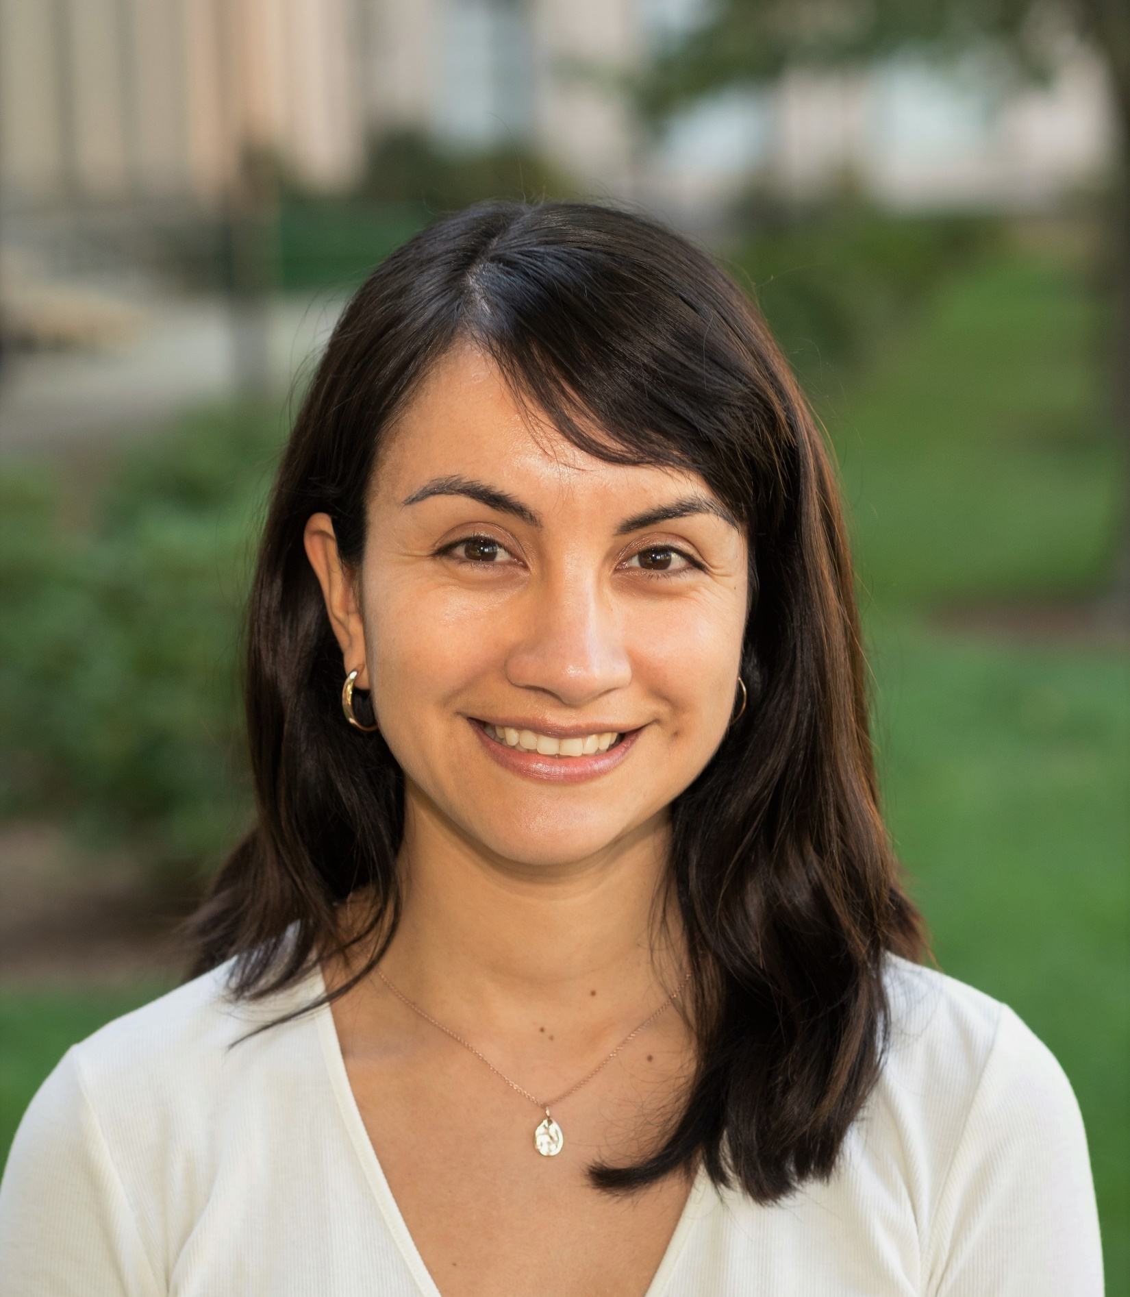



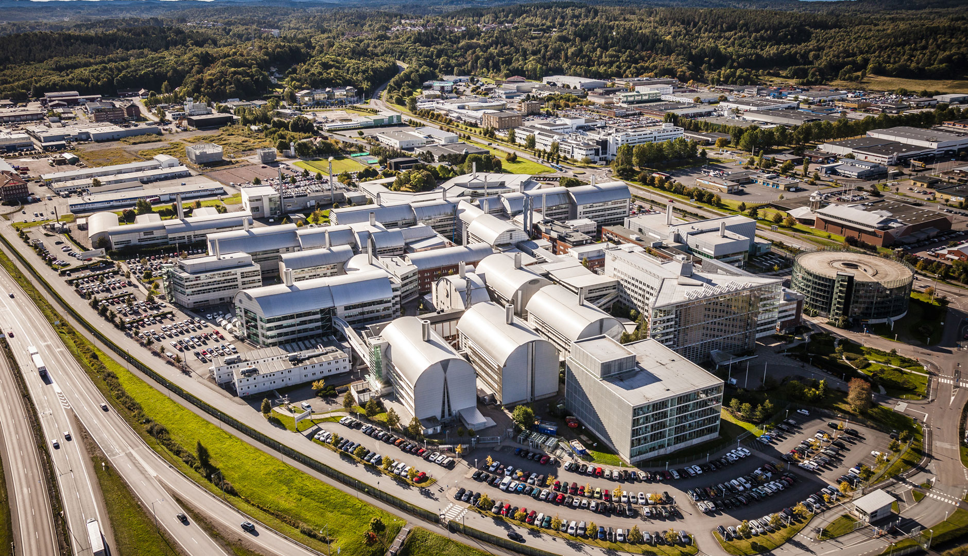


About me: Dr. Rocío Mercado
BSc Chemistry
2009 -2013
PhD Chemistry
2013 - 2018
Industry postdoc
2018 - 2021
Academic postdoc
2021 -
Introduction
Methods
Benchmarks
Outlook
Coley group
Department of Chemical Engineering, MIT
Molecular AI Team BioPharmaceuticals R&D AstraZeneca, Gothenburg

Slide 5
About me: Dr. Rocío Mercado
Research interests:
Deep generative models
Small molecule design
Molecular optimization
Low-data learning
Computational biochemistry
Synthesizability constrained generation
Software development
Open-source tools
Medicinal chemistry
Pharmaceutical drug discovery
Reinforcement learning
Introduction
Methods
Benchmarks
Outlook

Slide 6
The goals of this lecture are to teach you:
What are molecular generative models?
What types of models can we use for molecular design?
How do we evaluate a molecular generative model?
What are the {strengths|weaknesses} of current molecular generative models?
Introduction
Methods
Benchmarks
Outlook

Slide 7
(Deep) generative models are used accross a range of industries and applications.
face generation¹
3D shape reconstruction²
visualize effects of climate change³
Introduction
Methods
Benchmarks
Outlook
¹github.com/NVlabs/stylegan
²github.com/xiumingzhang/GenRe-ShapeHD
³Schmidt et al. arXiv:1905.03709, 2019. & github.com/junyanz/pytorch-CycleGAN-and-pix2pix

Slide 8
Generative models can also be used to design molecules with desired properties.
Introduction
Methods
Benchmarks
Outlook

Slide 9
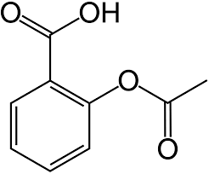

Generative models can also be used to design molecules with desired properties.
e.g.
good solubility
target activity
desired properties
low toxicity
synthesizable
molecular generative model
optimized molecules
molecular substructures
aspirin
Introduction
Methods
Benchmarks
Outlook
Save chemists time by narrowing down the chemical space of viable molecules faster and more efficiently.
Can be used in conjunction with existing (traditional) methods.

Slide 10
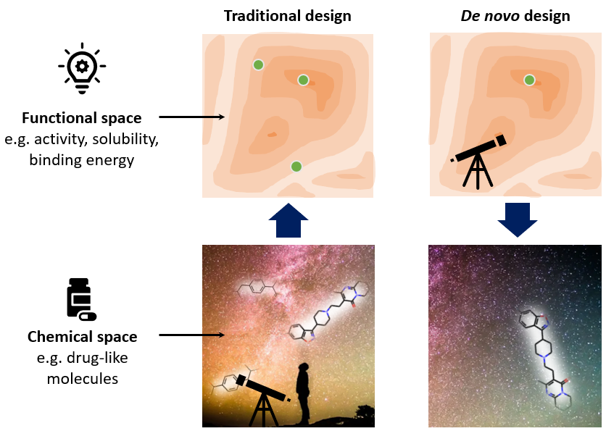
Two general approaches to molecular design.
narrow range of desired properties
(high-throughput screening)
we can use molecular generative models in either approach
Introduction
Methods
Benchmarks
Outlook
broad range of suitable properties

Slide 11
Many approaches to molecular generation.
Deep generative models
GANs
Combinatorial approaches
Evolutionary algorithms
Fragment-based design
Genetic algorithms
VAEs
Enumeration
…
…
…
Introduction
Methods
Benchmarks
Outlook

Slide 12
Many approaches to molecular generation.
Deep generative models
GANs
Combinatorial approaches
Evolutionary algorithms
Fragment-based design
Genetic algorithms
Enumeration
…
…
VAEs
…
Introduction
Methods
Benchmarks
Outlook

Slide 13
Methods
Introduction
Methods
Benchmarks
Outlook

Slide 14
Deep molecular generative models consist of multiple components, leading to significant variation.
Generation scheme
Single-shot
Autoregressive
Deep learning architecture
GNNs
RNNs
Optimization algorithm
Reinforcement learning
Genetic algorithm
Molecular representation
VAEs
GANs
Transformers
Strings
Graphs
3D conformers
Fingerprints
…
…
…
Introduction
Methods
Benchmarks
Outlook

Slide 15
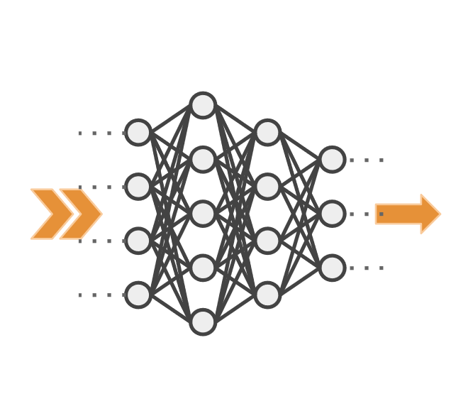
Deep molecular generative models use deep neural networks to generate molecules.
GANs
RNNs
VAEs
desired properties
molecular substructures
CNNs
deep neural network
FFNs
AEs
Introduction
Methods
Benchmarks
Outlook
GNNs

Slide 16
Deep molecular generative models consist of multiple components, leading to significant variation.
Generation scheme
Single-shot
Autoregressive
Deep learning architecture
GNNs
RNNs
Optimization algorithm
Reinforcement learning
Genetic algorithm
Molecular representation
VAEs
GANs
Transformers
Strings
Graphs
3D conformers
Fingerprints
…
…
…
Introduction
Methods
Benchmarks
Outlook

Slide 17
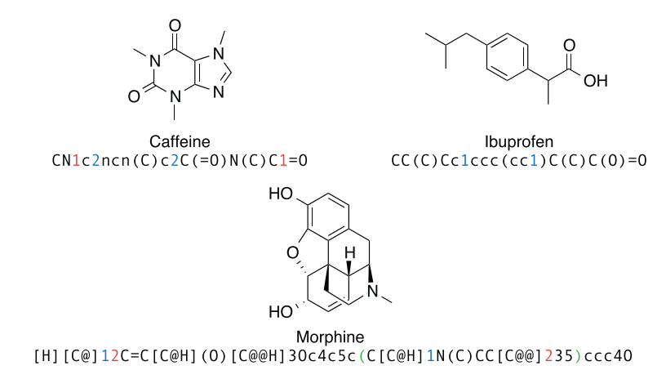
We can use a variety of representations to represent molecules in deep molecular generative models.
molecular fingerprints
ECFPs
…
(2D) graph representations
connection tables
adjacency matrices
node feature matrices
edge feature tensors
…
string representations
SMILES
DeepSMILES
SELFIES
Rxn SMILES
…
3D representations
coordinates
bond lengths
bond angles
shape-filling models
…
Introduction
Methods
Benchmarks
Outlook
review on molecular representations in AI-driven drug discovery
Figure from
Segler et al. arXiv:1701.01329. 2017.
Molecular representations review
David et al. J. Cheminf. 2020.

Slide 18
Deep molecular generative models consist of multiple components, leading to significant variation.
Generation scheme
Single-shot
Autoregressive
Deep learning architecture
GNNs
RNNs
Optimization algorithm
Reinforcement learning
Genetic algorithm
Molecular representation
VAEs
GANs
Transformers
Strings
Graphs
3D conformers
Fingerprints
…
…
…
Introduction
Methods
Benchmarks
Outlook

Slide 19
There are two main generation schemes used.
(1) Single-shot and (2) iterative (autoregressive)
Introduction
Methods
Benchmarks
Outlook

Slide 20
There are two main generation schemes used.
(1) Single-shot and (2) iterative (autoregressive)
sample
molecular generative model
Introduction
Methods
Benchmarks
Outlook

Slide 21
There are two main generation schemes used.
(1) Single-shot and (2) iterative (autoregressive)
first sample:
molecular generative model
A
adjacency matrix
Introduction
Methods
Benchmarks
Outlook

Slide 22
There are two main generation schemes used.
(1) Single-shot and (2) iterative (autoregressive)
then sample:
molecular generative model
X
node features
Introduction
Methods
Benchmarks
Outlook

Slide 23
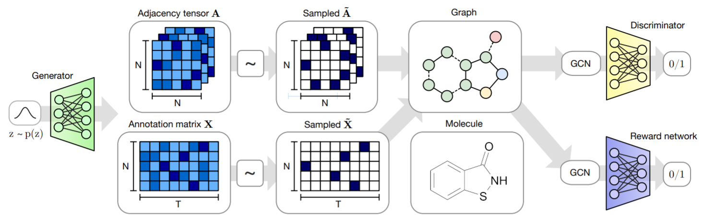
There are two main generation schemes used.
(1) Single-shot and (2) iterative (autoregressive)
Example:
MolGAN
Introduction
Methods
Benchmarks
Outlook
De Cao and Kipf. arXiv:1805.11973. 2018.
github.com/nicola-decao/MolGAN

Slide 24
There are two main generation schemes used.
(1) Single-shot and (2) iterative (autoregressive)
sample
molecular generative model
Introduction
Methods
Benchmarks
Outlook

Slide 25
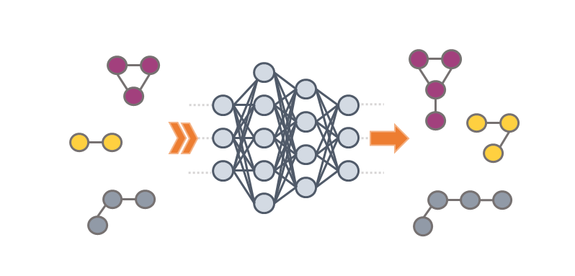
There are two main generation schemes used.
(1) Single-shot and (2) iterative (autoregressive)
Example:
GraphINVENT
Introduction
Methods
Benchmarks
Outlook
Mercado et al. Mach. Learn.: Sci. Technol. 2021.
github.com/MolecularAI/GraphINVENT

Slide 26
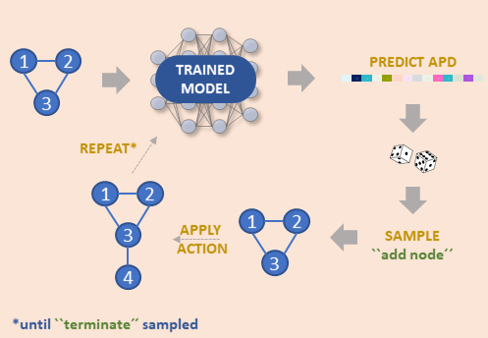
There are two main generation schemes used.
(1) Single-shot and (2) iterative (autoregressive)
(X, A)
GNN
(H^{L}, g)
APD
MLP
APD = action probability distribution
possible actions:
add edge/node
connect node
terminate graph
Introduction
Methods
Benchmarks
Outlook
Mercado et al. Mach. Learn.: Sci. Technol. 2021.
github.com/MolecularAI/GraphINVENT

Slide 27
Deep molecular generative models consist of multiple components, leading to significant variation.
Generation scheme
Single-shot
Autoregressive
Deep learning architecture
GNNs
RNNs
Optimization algorithm
Reinforcement learning
Genetic algorithm
Molecular representation
VAEs
GANs
Transformers
Strings
Graphs
3D conformers
Fingerprints
…
…
…
Introduction
Methods
Benchmarks
Outlook

Slide 28
Optimizing for desired properties is a complex, multi-objective task.
e.g. drug discovery:
Molecular properties to optimize
Binding to a known target
Target selectivity
Novelty
Physico-chemical properties
Stability
Solubility
ADMET properties
Adsorption
Desorption
Metabolism
Excretion
Toxicity
Synthetic accessibility
Production cost
etc
binding pocket
Protein target
candidate molecules
Introduction
Methods
Benchmarks
Outlook

Slide 29
Optimizing for desired properties is a complex, multi-objective task.
e.g. drug discovery:
Molecular properties to optimize
Binding to a known target
Target selectivity
Novelty
Physico-chemical properties
Stability
Solubility
ADMET properties
Adsorption
Desorption
Metabolism
Excretion
Toxicity
Synthetic accessibility
Production cost
etc
X
X
X
binding pocket
X
Protein target
candidate molecules
Introduction
Methods
Benchmarks
Outlook

Slide 30
Optimizing for desired properties is a complex, multi-objective task.
e.g. drug discovery:
Another protein
Molecular properties to optimize
Binding to a known target
Target selectivity
Novelty
Physico-chemical properties
Stability
Solubility
ADMET properties
Adsorption
Desorption
Metabolism
Excretion
Toxicity
Synthetic accessibility
Production cost
etc
X
X
X
binding pocket
X
X
Protein target
candidate molecules
Space of drug-like molecules:
10²³ – 10⁶⁰
Introduction
Methods
Benchmarks
Outlook
Is it the right mechanism of action?
challenges
Large number of interdependent properties

Slide 31
How do we do multi-objective optimization for molecules?
Train generative model
Optimize in the latent space
latent space
deep generative model
Introduction
Methods
Benchmarks
Outlook
vector

Slide 32
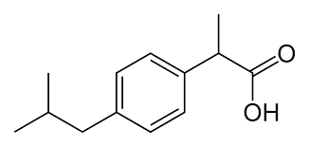
How do we do multi-objective optimization for molecules?
Train generative model
Optimize in the latent space
latent space
desired properties
deep generative model
optimized molecules
Introduction
Methods
Benchmarks
Outlook

Slide 33
How do we do multi-objective optimization for molecules?
Train generative model
Optimize in the latent space, or…
latent space
desired properties
deep generative model
Introduction
Methods
Benchmarks
Outlook

Slide 34
How do we do multi-objective optimization for molecules?
Train generative model
Increase likelihood of desirable molecules
probability space
desired properties
desirable molecule
Introduction
Methods
Benchmarks
Outlook

Slide 35
How do we do multi-objective optimization for molecules?
Train generative model
Increase likelihood of desirable molecules
probability space
desired properties
Introduction
Methods
Benchmarks
Outlook

Slide 36
There are a few common strategies for molecular optimization.
Transfer learning
Evolutionary algorithms
Bayesian optimization
Reinforcement learning
likelihood optimization
latent space optimization
latent space optimization
likelihood optimization
Introduction
Methods
Benchmarks
Outlook

Slide 37
There are a few common strategies for molecular optimization.
Transfer learning
Evolutionary algorithms
Bayesian optimization
Reinforcement learning
Introduction
Methods
Benchmarks
Outlook

Slide 38
There are a few common strategies for molecular optimization.
Transfer learning
Evolutionary algorithms
Bayesian optimization
Reinforcement learning
e.g. generate __ inhibitors:
GM_{θ1}⁽¹⁾
Task #1
DRD2
GM_{θ}
GM_{θ2}⁽²⁾
Task #2
JNK3
GM_{θ3}⁽³⁾
Task #3
GSK3β
GM = generative model with parameters θ
Introduction
Methods
Benchmarks
Outlook

Slide 39
There are a few common strategies for molecular optimization.
likelihood optimization
Transfer learning
Evolutionary algorithms
Bayesian optimization
Reinforcement learning
Step 2: fine-tune on a (smaller) set of __ inhibitors
GM_{θ1}⁽¹⁾
Task #1
DRD2
GM_{θ}
GM_{θ2}⁽²⁾
Task #2
JNK3
GM_{θ3}⁽³⁾
Task #3
GSK3β
Step 1: train on a large, general set of drug-like molecules (e.g. ZINC)
Introduction
Methods
Benchmarks
Outlook

Slide 40
There are a few common strategies for molecular optimization.
Transfer learning
Evolutionary algorithms
Bayesian optimization
Reinforcement learning
Introduction
Methods
Benchmarks
Outlook

Slide 41
There are a few common strategies for molecular optimization.
latent space optimization
Transfer learning
Evolutionary algorithms
Bayesian optimization
Reinforcement learning
latent space
desired properties
deep generative model
?
Introduction
Methods
Benchmarks
Outlook

Slide 42
There are a few common strategies for molecular optimization.
Transfer learning
Evolutionary algorithms
Bayesian optimization
Reinforcement learning
Introduction
Methods
Benchmarks
Outlook

Slide 43
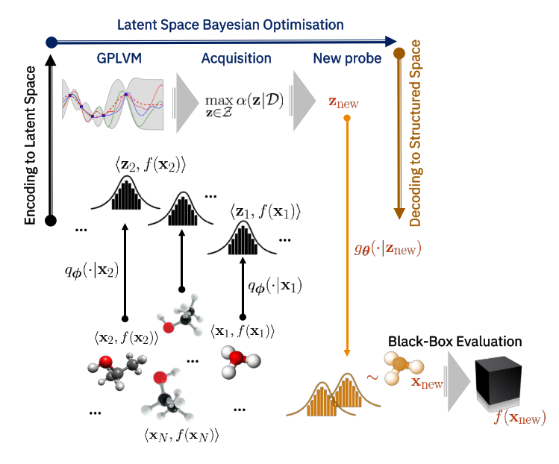

There are a few common strategies for molecular optimization.
latent space optimization
Transfer learning
Evolutionary algorithms
Bayesian optimization
Reinforcement learning
Example on next slide
Goal:
x = molecular representation
z = latent representation
f(·) = surrogate model (e.g. GP)
Introduction
Methods
Benchmarks
Outlook
Figure from
Grosnit et al. arXiv:2106.03609. 2021.
Notes:
From the paper: “There are two core components in BO; a surrogate model and an acquisition function. Gaussian processes (GPs) are the surrogate model of choice for f(·) as they provide accurate point estimates and maintain calibrated uncertainties that are pivotal for guiding exploration. The acquisition function is responsible for suggesting new input points x to query at each iteration of BO and is designed to trade off exploration and exploitation in the black-box objective. Upon completion of each iteration, the queried points are appended to the dataset of the surrogate model and it is retrained. This process continues ad libitum until a solution is obtained.”

Slide 44
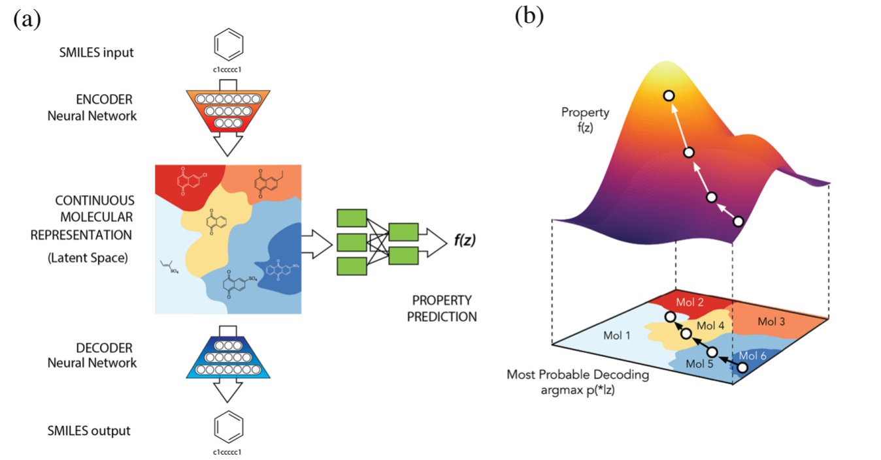
There are a few common strategies for molecular optimization.
Introduction
Methods
Benchmarks
Outlook
Example:
SMILES VAE
Gómez-Bombarelli et al. ACS Cent. Sci., 2018, 4, 268−276.
Notes:
From the paper: “Optimization of Molecules via Properties. We next optimized molecules in the latent space from the autoencoder which was jointly trained for property prediction. In order to create a smoother landscape to perform optimizations, we used a Gaussian process model to model the property predictor model. Gaussian processes can be used to predict any smooth continuous function41 and are extremely lightweight, requiring only a few minutes to train on a dataset of a few thousand molecules. The Gaussian process was trained to predict target properties for molecules given the latent space representation of the molecules as an input.”

Slide 45
There are a few common strategies for molecular optimization.
Transfer learning
Evolutionary algorithms
Bayesian optimization
Reinforcement learning
Introduction
Methods
Benchmarks
Outlook

Slide 46
There are a few common strategies for molecular optimization.
Transfer learning
Evolutionary algorithms
Bayesian optimization
Reinforcement learning
agent
reward
action
state
Introduction
Methods
Benchmarks
Outlook
environment

Slide 47
There are a few common strategies for molecular optimization.
likelihood optimization
Transfer learning
Evolutionary algorithms
Bayesian optimization
Reinforcement learning
generative model
Example on next slide
molecule score
sample molecules
state
Introduction
Methods
Benchmarks
Outlook
environment

Slide 48
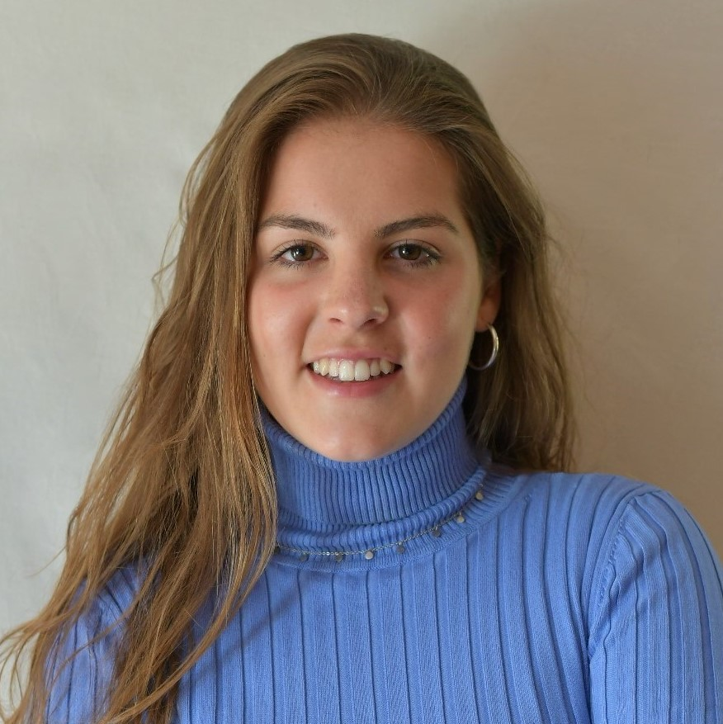


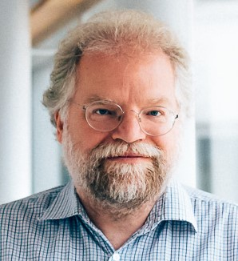

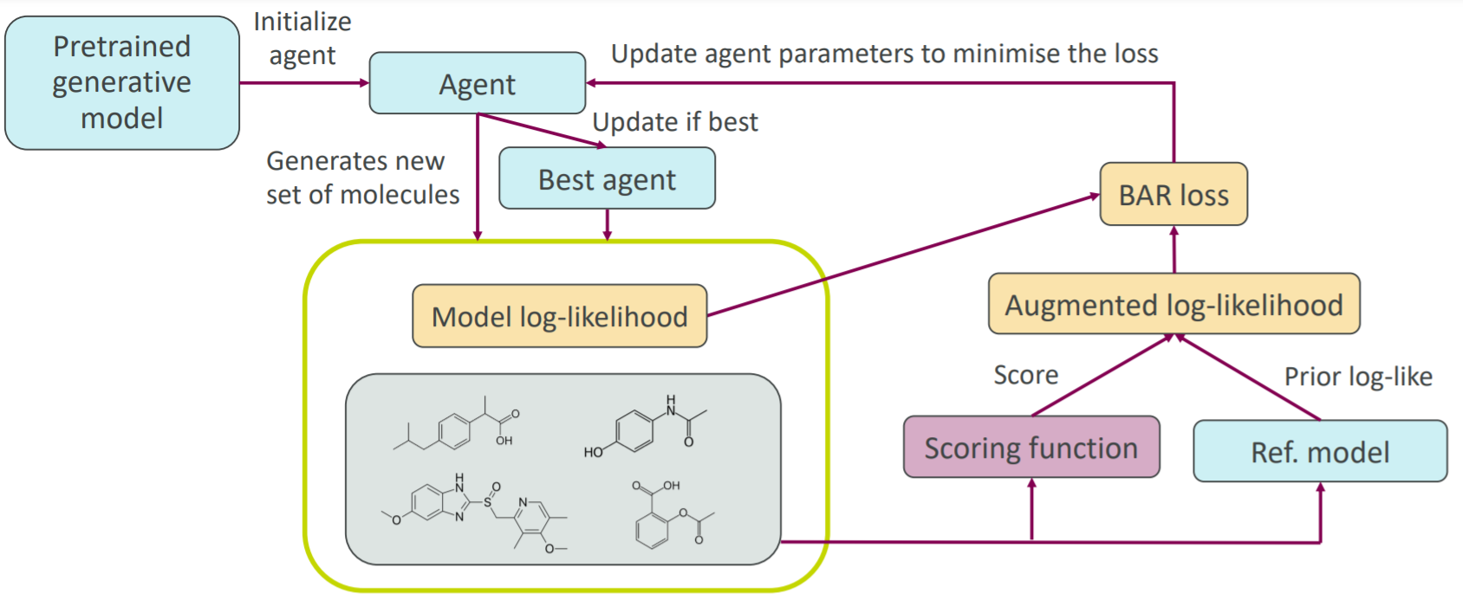
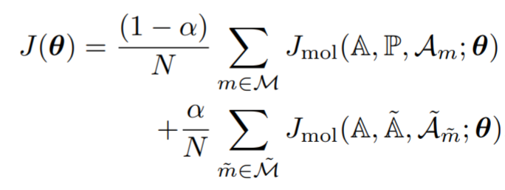
There are a few common strategies for molecular optimization.
keep track of:
current model A
best model so far Ã
prior model P
desired properties:
validity
uniqueness
activity
drug-likeness
…
Introduction
Methods
Benchmarks
Outlook
Romeo Atance et al. ChemRxiv. 2021.
& ICML RL4RealLife Workshop.
github.com/olsson-group/RL-GraphINVENT

Slide 49
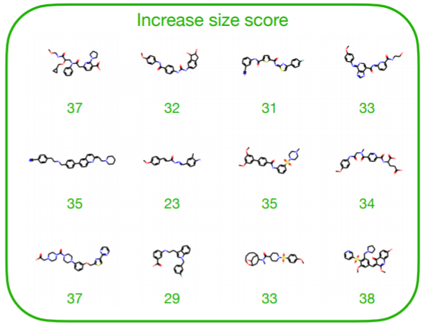
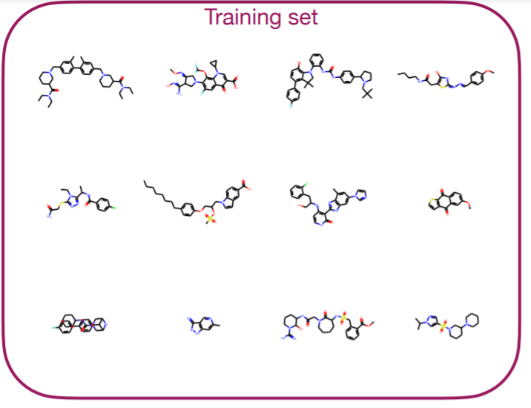
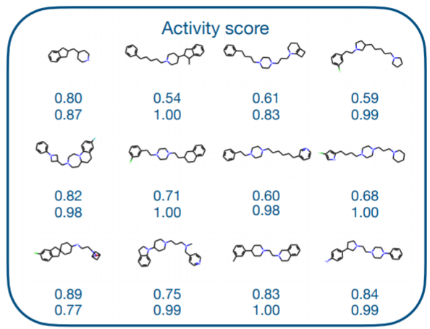
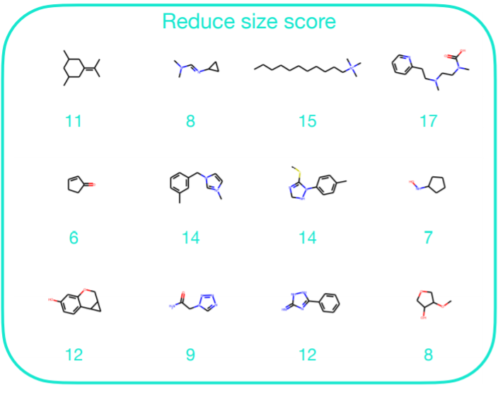
There are a few common strategies for molecular optimization.
Three tasks:
Generate DRD2 actives
Increase molecule size
Decrease molecule size
Introduction
Methods
Benchmarks
Outlook
Romeo Atance et al. ChemRxiv. 2021.
& ICML RL4RealLife Workshop.
github.com/olsson-group/RL-GraphINVENT

Slide 50
Deep molecular generative models consist of multiple components, leading to significant variation.
Generation scheme
Single-shot
Autoregressive
Deep learning architecture
GNNs
RNNs
Optimization algorithm
Reinforcement learning
Genetic algorithm
Molecular representation
VAEs
GANs
Transformers
Strings
Graphs
3D conformers
Fingerprints
…
…
…
Introduction
Methods
Benchmarks
Outlook

Slide 51
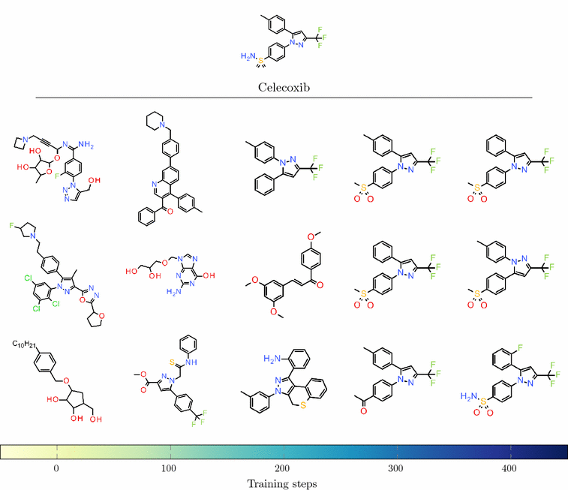
In molecular optimization, we want to balance exploration vs exploitation.
Introduction
Methods
Benchmarks
Outlook
Example:
REINVENT
Figure from
Olivecrona et al. J. Cheminform., 2017, 9, 48.
Notes:
Figure caption: “Evolution of generated structures during training Structures sampled every 100 training steps during the training of the Agent towards similarity to Celecoxib with k=0.7 and σ=15.”

Slide 52
Benchmarks
Introduction
Methods
Benchmarks
Outlook

Slide 53
How do we evaluate and compare molecular generative models?
A few different benchmarks and metrics:
MOSES
GuacaMol
chemical space coverage
Introduction
Methods
Benchmarks
Outlook

Slide 54
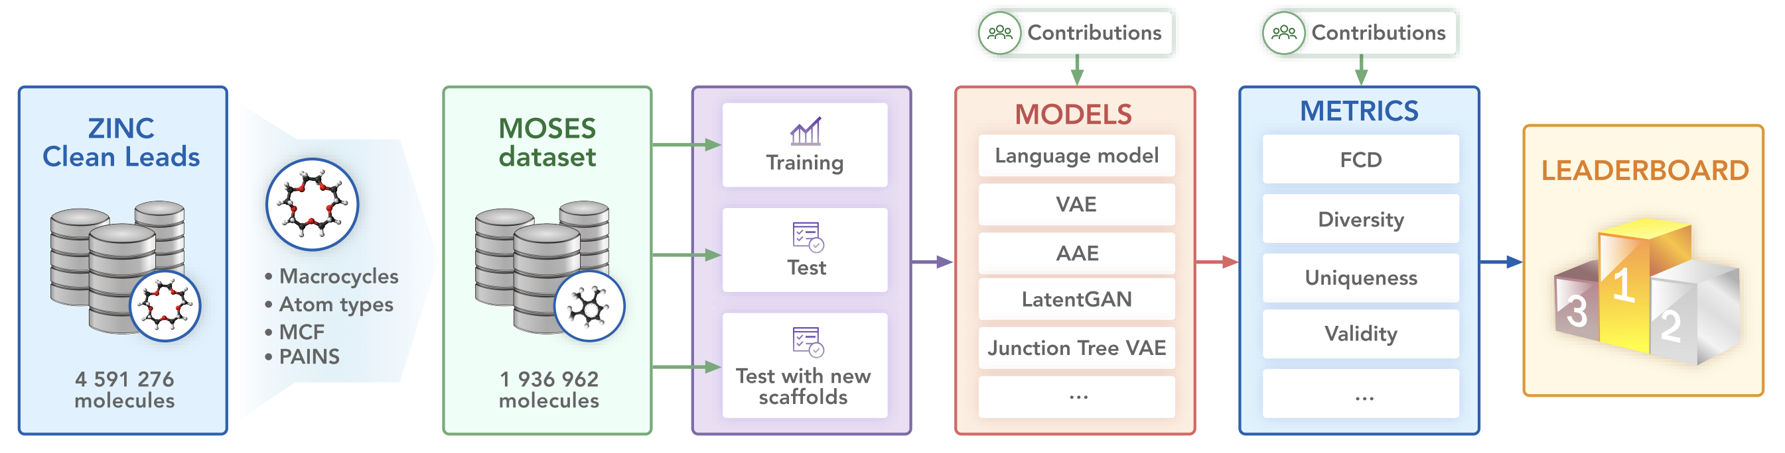
MOSES (Molecular Sets) looks at distribution-based metrics for evaluating models.
Introduction
Methods
Benchmarks
Outlook
Polykovskiy et al. arXiv:1811.12823, 2020.
github.com/molecularsets/moses

Slide 55
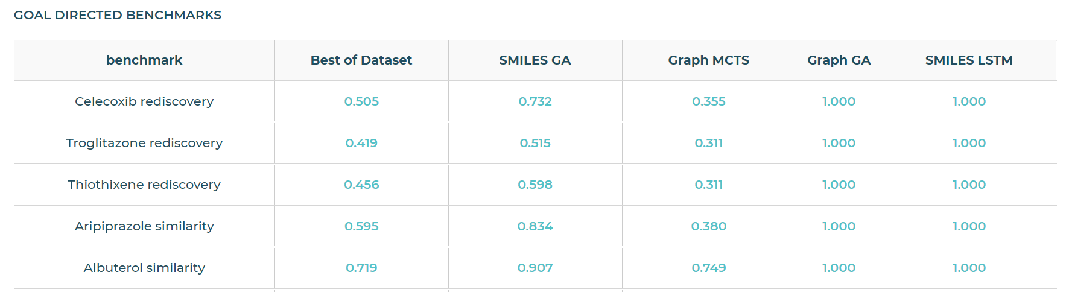
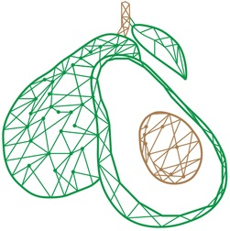
GuacaMol looks at distribution-based and goal-directed evaluation metrics.
Introduction
Methods
Benchmarks
Outlook
Brown et al. arXiv:1811.09621, 2019.
github.com/benevolentAI/guacamol

Slide 56
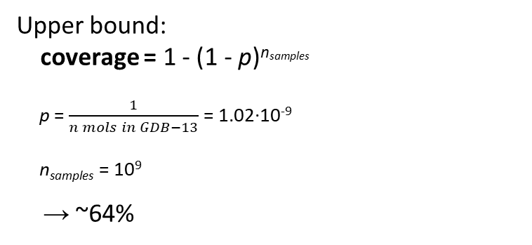
It can also be informative to quantify the chemical space coverage of a generative model.
GDB-13
Upper bound: coverage = 1 - (1 - p)^{nsamples}
p = $\frac{1}{n mols in GDB−13}$ = 1.02∙10⁻⁹
n_{samples} = 10⁹
→ ~64%
chemical space coverage
(↑ better)
training set
generative model
GDB-13 small organic molecules, ≤13 HAs 975 million molecules {C, N, O, S, Cl}
Introduction
Methods
Benchmarks
Outlook
Arús-Pous et al. J Cheminform., 2019, 11:20.
Zhang et al. JCIM. 2021, 61, 6, 2572–2581.
github.com/jeah-z/Generative_Models_benchmark_gdb13

Slide 57
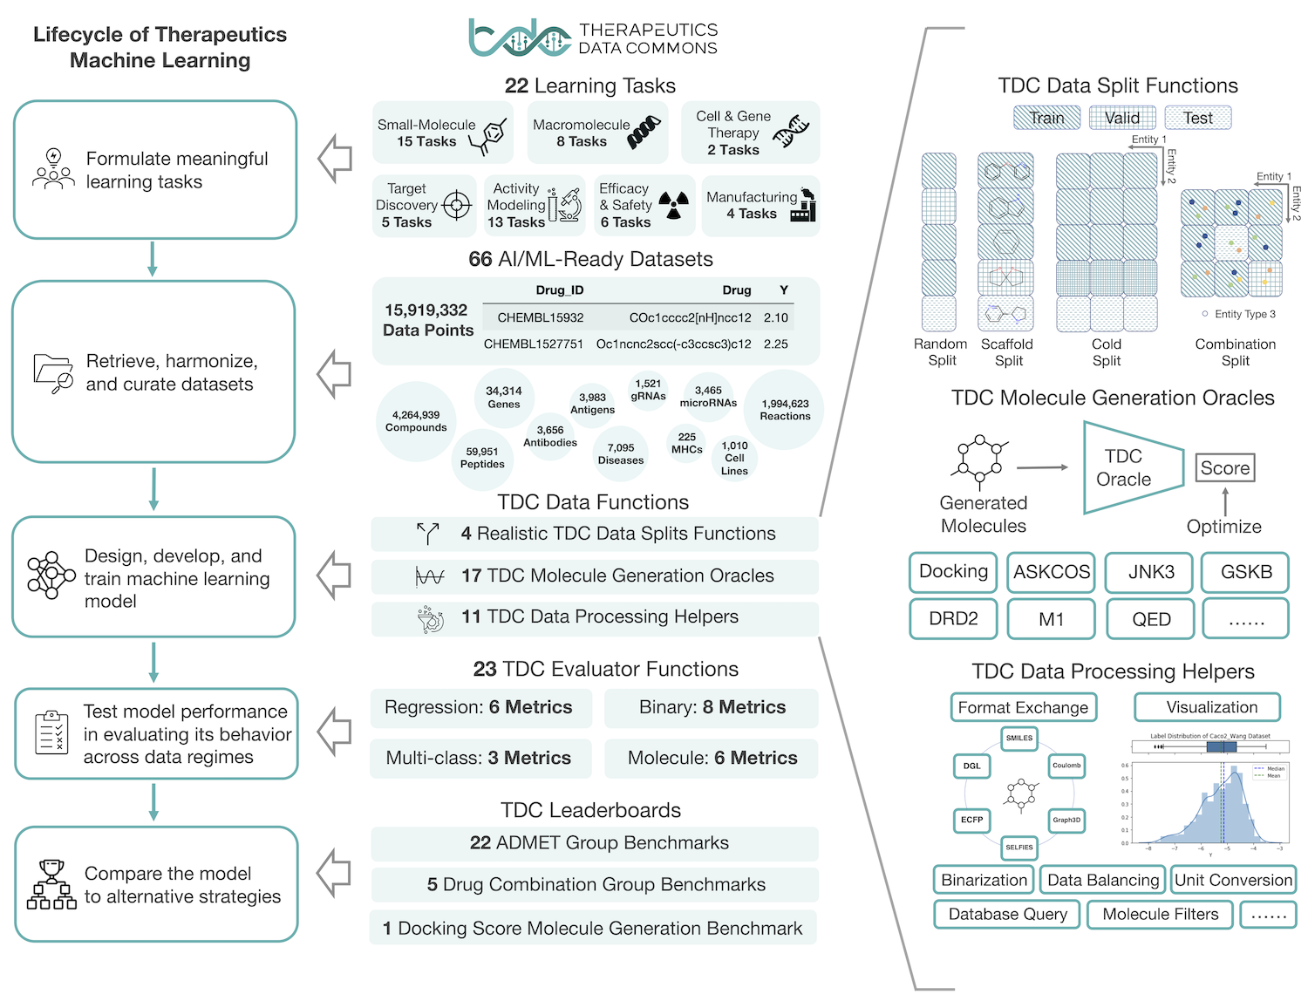
The Therapeutics Data Commons (TDC) has nice implementations of many of these benchmarks under one framework.
Introduction
Methods
Benchmarks
Outlook
Huang et al. Proc. NeurIPS, 2021.
tdcommons.ai

Slide 58
Outlook
Introduction
Methods
Benchmarks
Outlook

Slide 59
Molecular generative models are a promising way of designing molecules.
Can leverage large amounts of data
A variety of architectures/representations to choose from, each with benefits & deficiencies
Can optimize over a high-dimensional landscape
Multi-objective optimization
Can assign error-prone decisions to computer
Error and uncertainty quantification
Quick to train
<1 week in most cases, versus 3-7 years for PhD in chemistry + years of experience in industry
Introduction
Methods
Benchmarks
Outlook

Slide 60
Nonetheless, many challenges and opportunities for development remain in the field of molecular generation.
Molecular size limitations
Large disk space and memory requirements
Lack of synthesizability constraints
Lack of 3D information
(For drug discovery) Handling protein information
Downstream properties can be optimized earlier on
Introduction
Methods
Benchmarks
Outlook

Slide 61






Acknowledgments
contact info
@rociomer3
rociomer@mit.edu rociomer.github.io
Molecular AI past and present, especially: Sara Romeo Atance Juan Viguera Diez Julio Ponte Hernández Tobias Rastemo Edvard Lindelöf Dr. Atanas Patronov Dr. Samuel Genheden Dr. Esben J. Bjerrum Dr. Ola Engkvist Prof. Hongming Chen
Chalmers: Prof. Simon Olsson
JKU Linz: Prof. Günter Klambauer
Coley Group
Thank you for your attention!

Slide 62
References and recommended reading
Molecular and reaction representations:
David et al. J. Cheminf., 2020, 12:56. link
Warr, Wendy. Molec. Inf., 2014, 33(6-7), 469–476. link
Benchmarks and evaluation frameworks:
(MOSES) Polykovskiy et al. arXiv:1811.12823, 2020. link
(Guacamol) Brown et al. J. Chem. Inf. Model., 2019, 59, 3, 1096–1108. link
(Chemical space coverage) Arús-Pous et al. J Cheminform., 2019, 11:20. link
(Therapeutics Data Commons) Huang et al. Proc. NeurIPS, 2021. link
Deep molecular generative models*:
(SMILES LSTM) Segler et al. arXiv:1701.01329. 2017. link
(REINVENT) Olivecrona et al. J. Cheminform., 2017, 9, 48. link
(MolGAN) De Cao and Kipf. arXiv:1805.11973. 2018. link
(SMILES VAE) Gómez-Bombarelli et al. ACS Cent. Sci., 2018, 4, 268−276. link
(GraphINVENT) Mercado et al. Mach. Learn.: Sci. Tech., 2021, 2, 025023. link
(RL-GraphINVENT) Romeo Atance et al. ChemRxiv. 2021. link
*many, many, many more generative models which I did not talk about… this is not a complete list!

